Slide 1


Attention Mechanism and Transformers
Video 7: Introduction to Transformers

Slide 2
IN AIR

Slide 3

ChatGPT

Slide 4
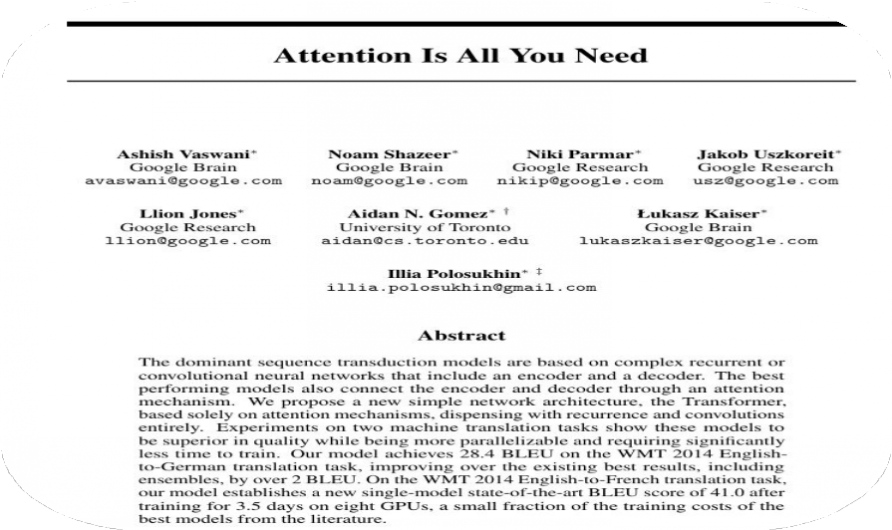
Transformers
Purpose: Addresses sequence-to-sequence issues with long-range dependencies.
Impact: Integral to NLP, driving advancements like BERT, GPT 2, T5, Chat GPT.

Slide 5
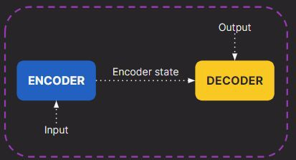
Recap
Encoder - Decoder
Encoder state : solely responsible to transfer information to decoder.

Slide 6
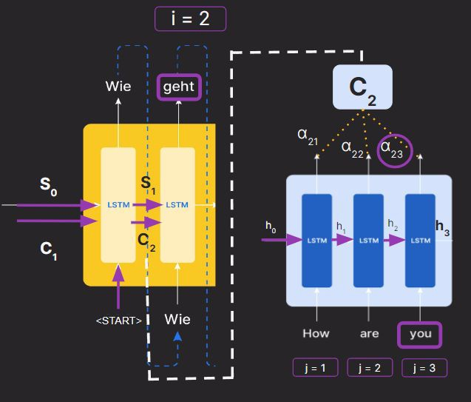
Recap
Encoder - Decoder
Attention Mechanism
C_{i}
= ∑ α_{ij}h_{i}
Encoder state : solely responsible to transfer information to decoder.
Calculation of alpha increase computation for long documents.
Encoder processes the input sequentially

Slide 7
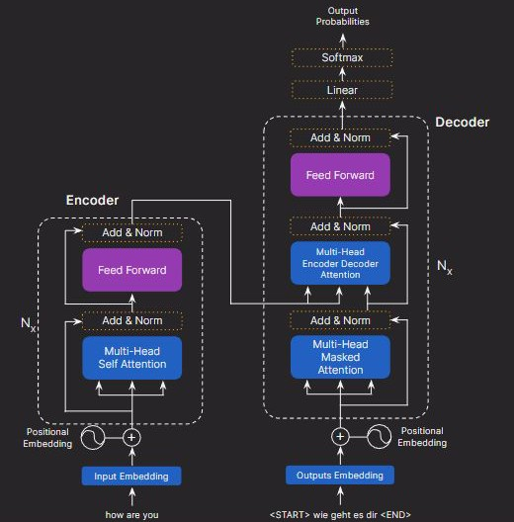
Architecture
Attention
Encoder-Decoder Attention
Self Attention Masked Attention Multi-Head Attention

Slide 8
Encoder - Decoder Attention

Slide 9
Encoder- Decoder Attention
C_{i}= ∑ α_{ij}h_{i}
Uses Dot-Product attention to calculate attention.
Context Vector = Softmax ( Q . K^{T} )* V
√d^{k}

Slide 10
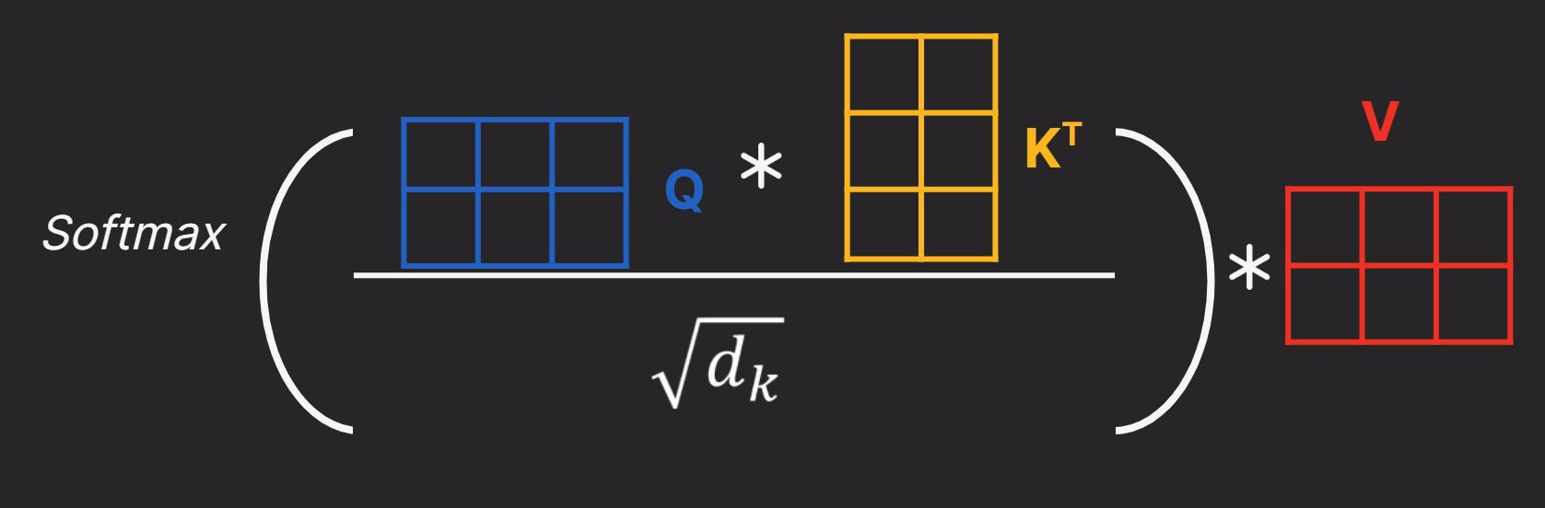
Dot Product Attention
Transposed Key Matrix
Query Matrix
Context Vector =
Value matrix
Square root of embedding dimension

Slide 11
Dot Product Attention
C_{i}
= ∑ α_{ij}h_{i}
Context Vector =
= Z
Hidden States
Attention weights
∑α_{ij}
h_{j}

Slide 12



Dot Product Attention
Query Vector : Importance of Relative Words
Key Vector : Represents Evaluated Word
Value Vector : Contains focussed information

Slide 13
Translate English to German:
"How are you?"
"Wie geht es dir?"

Slide 14
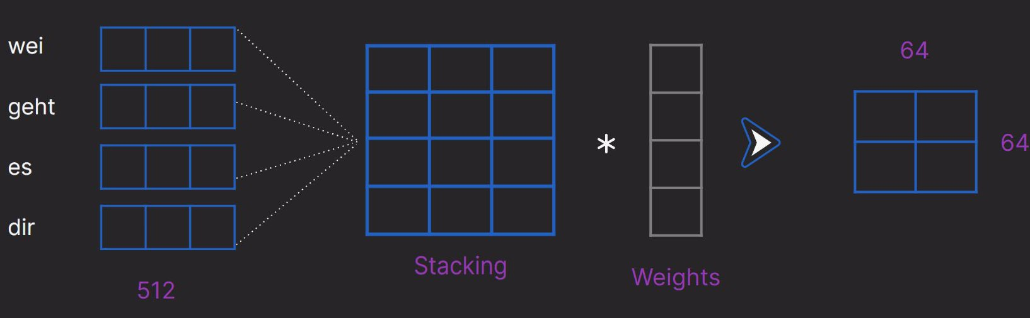
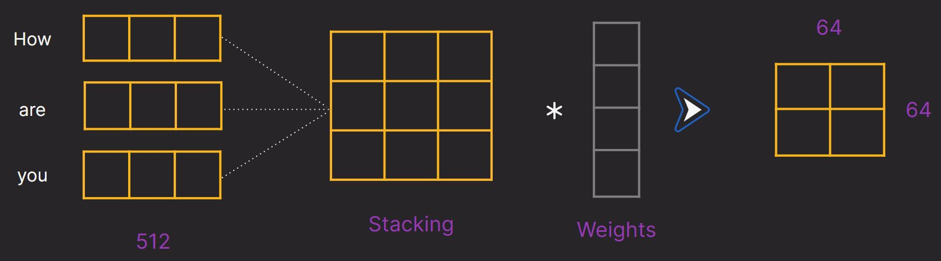
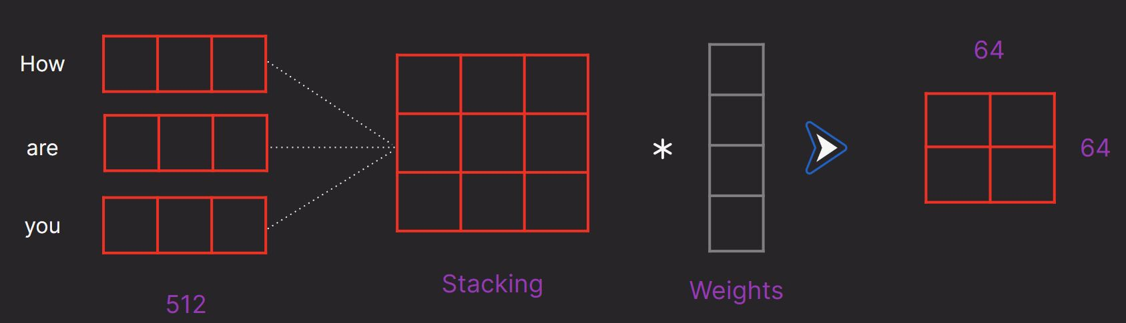
Encoder-Decoder Dot Product Attention
Query Vector
Key Vector
Value Vector

Slide 15
Encoder-Decoder Dot Product Attention
Cv = Softmax ( Q . K^{T} )* V
√d^{k}
Context Vector =
Z

Slide 16
Encoder-Decoder Dot Product Attention
Wie
geht
es
dir
How
are
you

Slide 17
Attention
Encoder-Decoder Attention
Self Attention Masked Attention Multi-Head Attention

Slide 18

Self Attention
The animal didn't cross the street because it was too tired.
The animal didn't cross the street because it was too crowded.
What does “it” refer to in these sentences?

Slide 19

Self Attention
The animal didn’t cross the street because it
was too tired
.
The animal didn’t cross the street because it
was too
crowded
.
The animal didn't cross the street because it was too wide.
The
The
animal didn’t cross the
animal
didn’t cross the
street
street
because it
was too
because
it
was too
crowded
tired
.
The animal didn't cross the street because it was too tired.
.

Slide 20
Self Attention
The animal didn’t cross the street because it
was too tired
.
The animal didn’t cross the street because it
was too
crowded
.
The animal didn't cross the street because it was too wide.
The
The
animal didn’t cross the
animal
didn’t cross the
street
street
because it
was too
because
it
was too
tired
crowded
.
The animal didn't cross the street because it was too tired.
.

Slide 21
Self Attention
C_{v} = Softmax ( Q . K^{T} )* V
√d^{k}
Q = Query Vector K = Key vector
V = Value vector
d^{k}= dimension of key vector

Slide 22
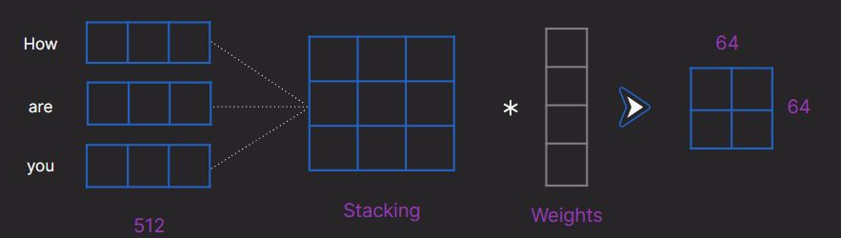
Self Attention
Query Vector
Key Vector
Value Vector

Slide 23
Self Attention
How
are
you
How
are you

Slide 24
Architecture
Attention
Encoder-Decoder Attention
Self Attention Masked Attention Multi-Head Attention

Slide 25
Masked Attention
Wie
geht
es
dir
Wie
geht
es
dir

Slide 26
Architecture
Attention
Encoder-Decoder Attention
Self Attention Masked Attention
Multi-Head Attention

Slide 27


Multi-Head Attention
Heads
How
are you
Stacking
Weights
512

Slide 28
Architecture
Attention
Encoder-Decoder Attention
Self Attention Masked Attention Multi-Head Attention

